Slide 1
Hackathon’25 : Solve Rubik’s Cube
Presented by: SHAIK MOHAMMED JUNAID

Slide 2
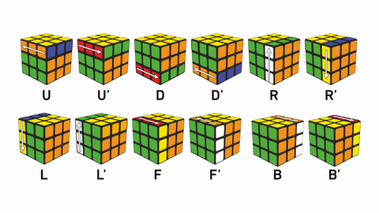
Solve Rubik’s Cube
Overview
Participants are challenged to design and implement an algorithm that can solve a standard 3x3 Rubik’s Cube from any scrambled state. The solution must mimic the real-world logic of solving a cube through a sequence of valid moves.
What We’re Looking For : 🔍
Problem-Solving Approach
How do you break down the problem?
How do you model the cube’s state and transitions?
Use of Data Structures
How do you represent the cube internally (e.g., arrays, trees, graphs)?
Use of efficient structures to track states and operations.
State Prediction Logic
Ability to track and predict cube state after each move.
Design of a move engine to simulate rotations and track permutations.
Algorithm Efficiency
How fast can your solution reach the solved state?
Complexity (time and space) of your algorithm.
Bonus Evaluation Areas
Creativity in solution design.
Visual simulation or cube UI (optional but Wow factor).
Scalability for different cube sizes (2x2, 4x4, etc.) : Optional
Deliverables:
Working algorithm (code)
Brief walkthrough/presentation of your approach
Output example(s) from your solver
It’s Not Just a Puzzle - It’s a Test of Mind, Math, and Moves!

Slide 3
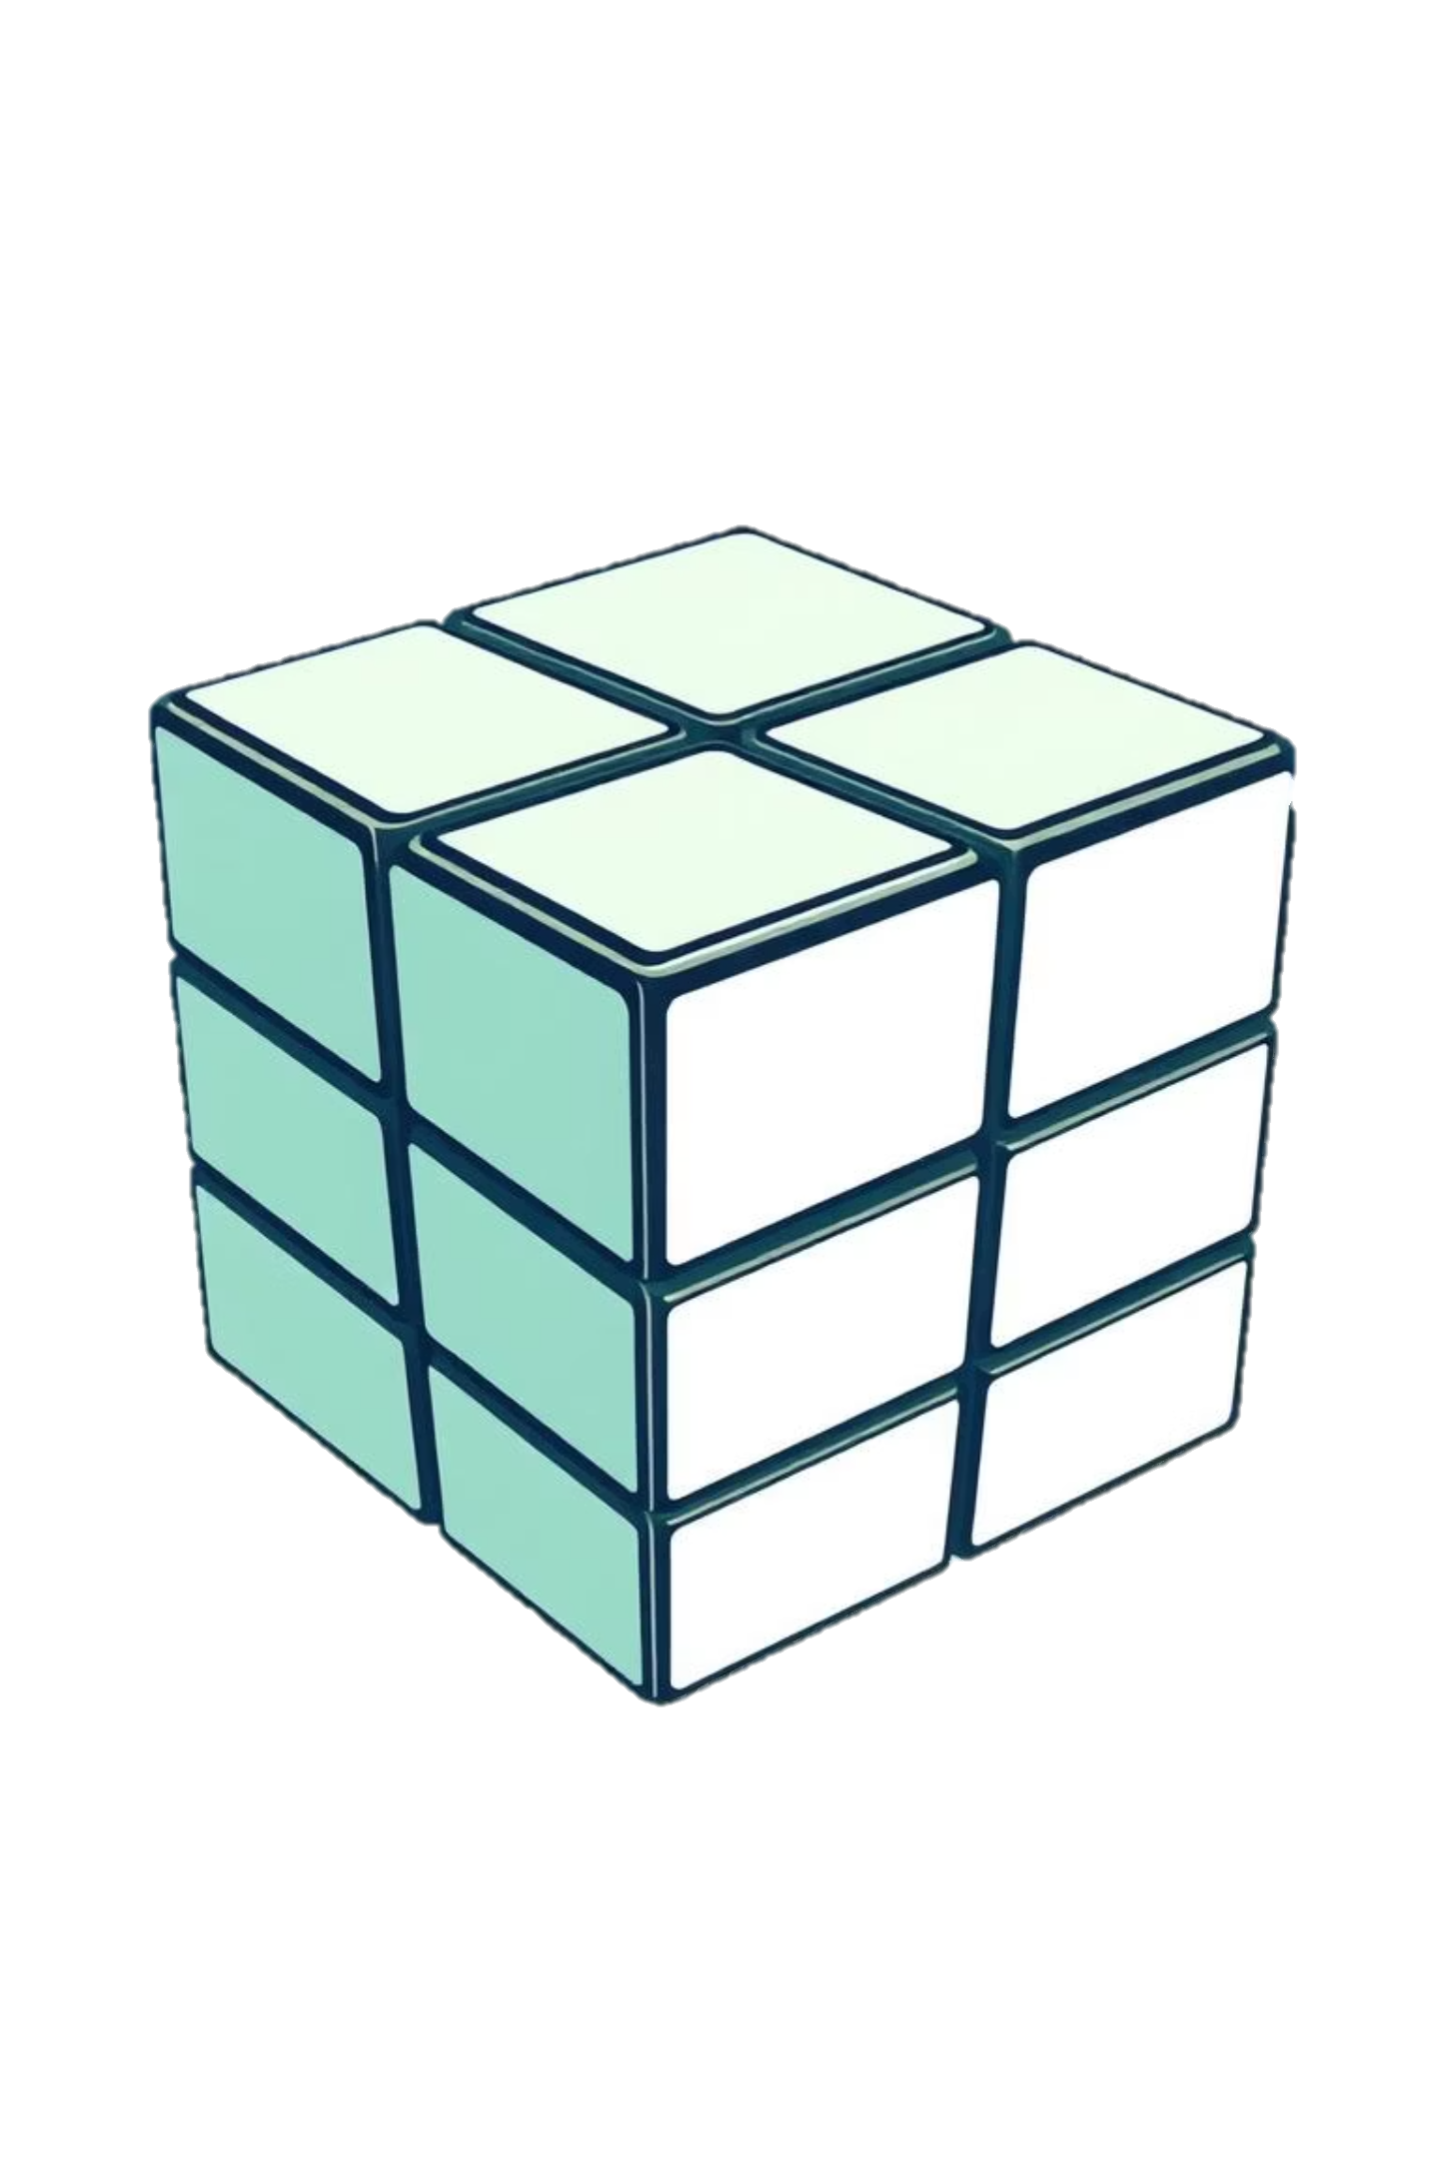
The Enigma of the Rubik's Cube
A Combinatorial Challenge
1
The Rubik's Cube boasts over 4.3 x 10^19 possible permutations, making manual solving incredibly complex and time-consuming for beginners.
Accessibility Barrier
Many find the cube daunting, leading to frustration. Our solver aims to demystify the process, making it accessible to everyone.
2

Slide 4
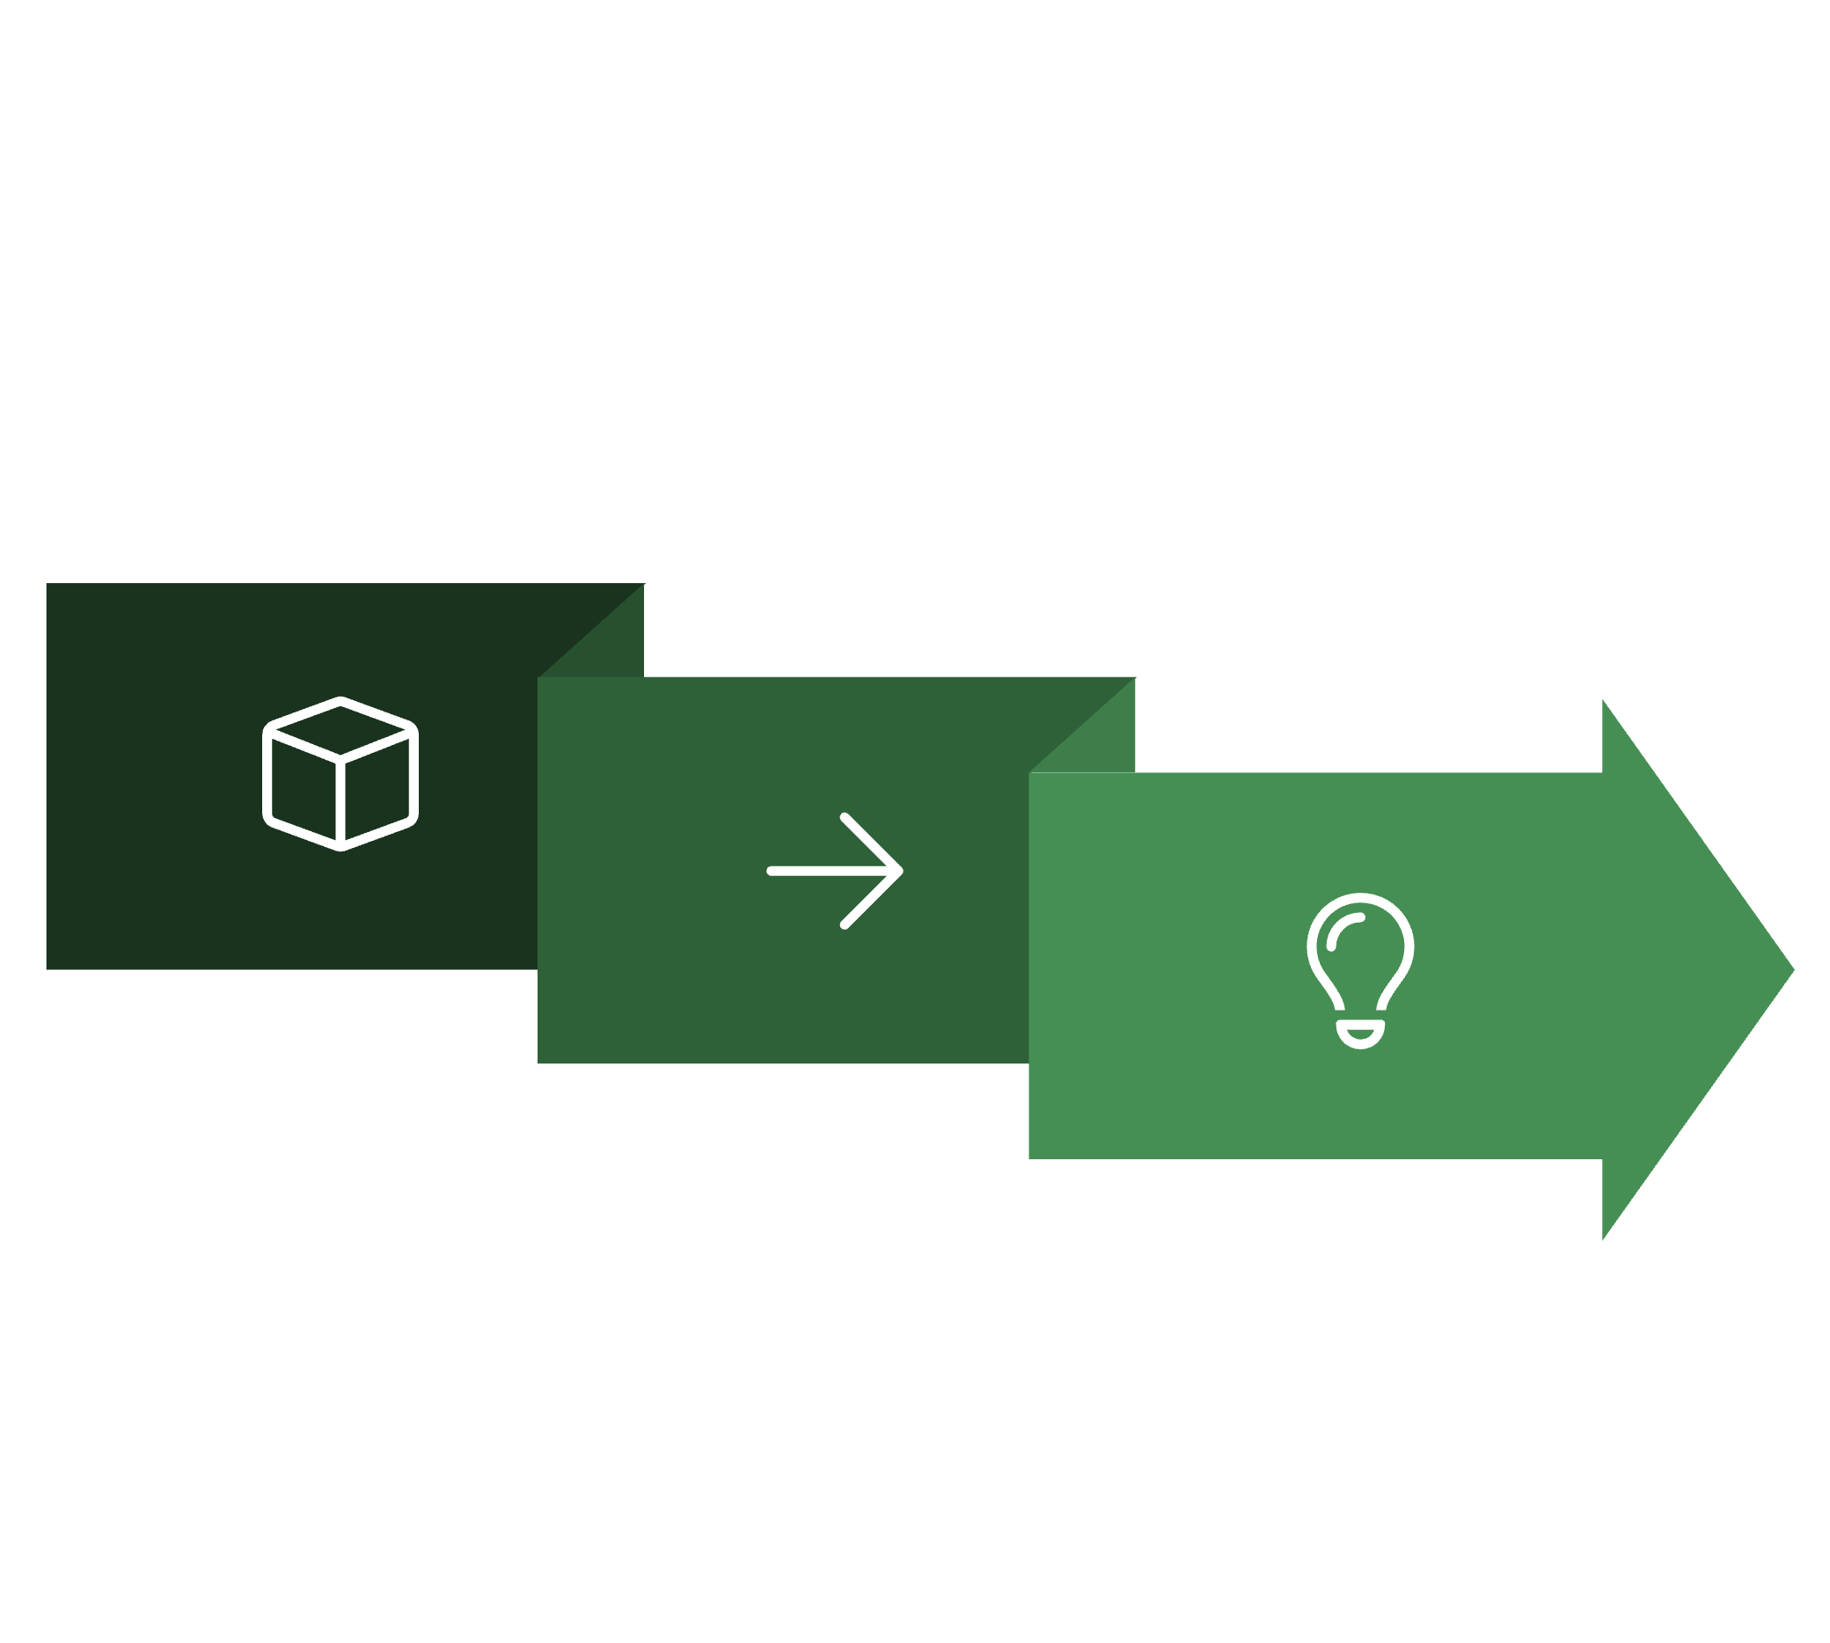
Solution Architecture: Kociemba's Algorithm
Sing the renowned Kociemba's Two-Phase Algorithm known for its efficiency in finding near-optimal solutions.
Phase 1: Reduce to G1
Phase 2: Solve G1 to Complete
Transition

Slide 5




Implementation Details: Python & Tkinter
Python Foundation
Kociemba Library
Integration with the highly optimised kociemba library provides the powerful solving algorithm at the heart of our solution.
The core logic is implemented in Python, ensuring rapid development and compatibility across various platforms.
Custom Cube Class
Tkinter GUI
A custom Cube class manages cube states, applies moves, and simulates rotations, forming the backbone of the solver's interaction with the algorithm.
A user-friendly graphical interface built with Tkinter allows for intuitive interaction, from inputting scrambles to visualising solutions.

Slide 6



Interactive Features for Enhanced User Experience
Animated Solutions
Observe each cube rotation in a smooth, step-by-step animation demystifying the solving process.
Intuitive GUI Controls
Effortlessly Scramble, Solve and Reset the cube using clearly labelled buttons for a seamless experience.
Step-by-Step Visualisation
Follow the solution move-by-move, ideal for learning the algorithm or understanding complex sequences.

Slide 7
Competitive Advantage: Speed and Optimisation
18-20
30ms
Optimal Moves
Blazing Fast Solving
Our solver consistently finds solutions in an impressive 18-20 moves, adhering closely to optimal paths.
The algorithm computes solutions in under 30 milliseconds, providing near-instant results.
This unparalleled speed and solution quality are key differentiators, making our solver a leading solution in its class.

Slide 8
Project Versatility and Extendability
Modular Design
Hackathon Ready
The architecture is highly modular, allowing for easy integration of new features or alternative algorithms.
Developed with hackathon constraints in mind, the project is robust, functional, and ready for further rapid iteration.
Extendable Platform
The clear codebase and well-defined interfaces facilitate future expansions, ensuring long-term usability and development potential.

Slide 9



Future Scope: Enhancing the Solver
QR Scanner Input
3D Web Viewer
Multi-Cube Support
Implement a QR code scanner for quick and effortless cube state input, streamlining the user experience.
Develop a sophisticated 3D web-based visualiser for a more immersive and interactive cube animation.
Expand functionality to support different cube sizes and variants (e.g., 4x4, 5x5), broadening the solver's utility.

Slide 10
Rubik's Cube Solver: Quick Pitch
Problem Solved: Demystifies Rubik's Cube complexity with an intuitive, efficient solver.
Tech Core: Leverages Kociemba's algorithm, Python, and Tkinter for robust performance.
Key Features: Animated step-by-step solutions, user-friendly GUI, and ultra-fast solving.
Advantage: Optimal solutions (18-20 moves) in under 30ms, highly modular and extensible.
Future Vision: QR input, 3D web viewer, and multi-cube support for expanded functionality.
Our project showcases a perfect blend of advanced algorithms and practical implementation, ready for real-world application.

Slide 11
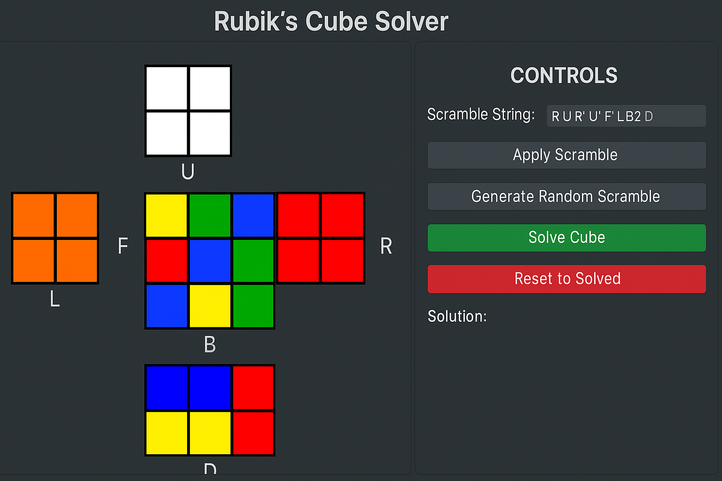
Working/output

Slide 12


